Slide 1
Facilitator Guide
MODULE 02: LAY OF THE LAND
  It’s time for you to lead module 2 of “Your Money Adventure.” We built modules 2 and 3 to complement each other. Module 2 gives an intro into expenses, spending, and saving with a heavy focus on saving. Module 3 will be focused on ways to spend smart.
  Many of the same guidelines you followed for Module 1 are true for Module 2, so you’ll see those guidelines below. We’ll also add that by Module 2, you’re starting to become more familiar with the teens. You’re noticing who jumps in to participate and who rarely shares. Never pressure the teens to share, but now might be a good time to start to encourage some participation from teens you haven’t heard from yet.
  As is always the case, if you have time at the end, open up the floor to questions and discussion. Maybe they’ll have questions about what you covered or questions about things coming up in the curriculum.
  You’ll see speaker notes on each slide that read like a script, but we encourage you to ad lib, put it in your own voice, and (*very importantly*) don’t read this word-for-word (that’s a way to lose the teens quick!).
  Sprinkled throughout the speaker notes are bracketed Facilitator Notes that we’ve left for you. These notes offer extra context for the slide, but you should not read those aloud while facilitating.
  We highly recommend you practice each module aloud before delivering it to the teens, especially because there are places where you need to add a personal story/example. This practice will help you connect to the message and deliver it authentically.
  On the next page, you’ll find timestamps for how long each section of the module should take. Keep track as you’re presenting to see if you are too far ahead or behind. If you are, make an adjustment.
  We’ve also found that facilitators who use dual monitors have better engagements during virtual presentations. Put the deck in play mode on your second screen and share that screen. Then, have your speaker notes on your main screen where your camara is. Move the speaker notes to as close to the top of the screen as possible so you can maintain eye contact while presenting.
  Throughout the modules, you’ll be sharing your screen, sending the teens to breakout rooms, using the poll and white board features, and managing the chat. Make sure you are comfortable with all of these interaction tools.
  We know teens can be intimidating but think about how THEY are feeling – finance is intimidating...money is intimidating! Be empathetic to that. Take your time with these concepts and show them this stuff doesn’t have to be as inaccessible as they may think.
  You’re not a regular facilitator, you’re a cool facilitator...WE know that, but teens don’t. They don’t think you’re cool. And that’s ok! Lean into it. Don’t be afraid to geek out a bit. Finance is your jam!
  Start strong. You set the tone for the entire curriculum on day one – really in the first 30 seconds on day one. Especially when you have to delivery virtually, YOU will need to bring the energy to their screens through your voice, your gestures, and your engagement with the material and to the students.
  Every audience, whether they’re adults or teen, will pay more attention to what you say if you to show passion and enthusiasm for the topic you’re presenting on. Tap into the awesome fact that you get to help young people on their road to financial success! Now THAT’S something to get excited about! Let your enthusiasm and excitement be infectious! It will carry you a long way.
  Hide or delete the facilitator guide before facilitating the module.

Slide 2

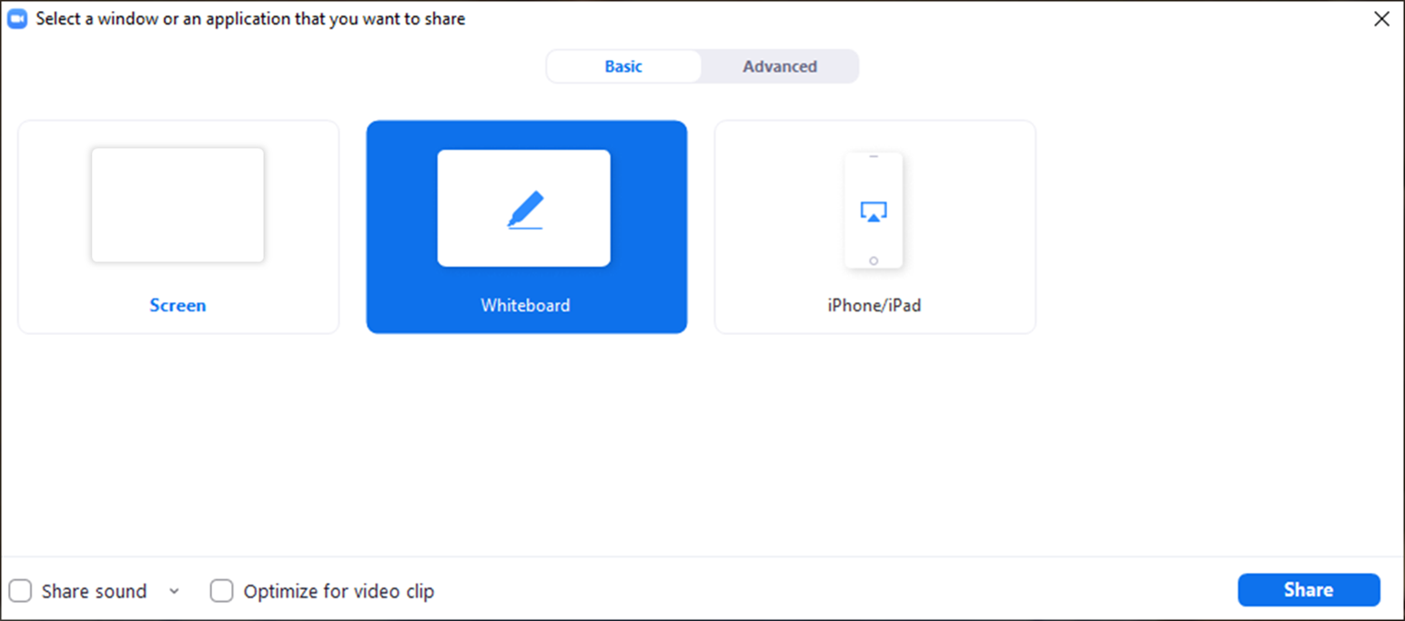
Facilitator Guide
MODULE 02: LAY OF THE LAND
  Tech Considerations:
  Whiteboard
  Using the Whiteboard: To use the whiteboard function in zoom you select “Share Screen” and then select the “Whiteboard” option in the pop up. Once the whiteboard opens select “Text” and you will be able to type directly onto the whiteboard.

Slide 3
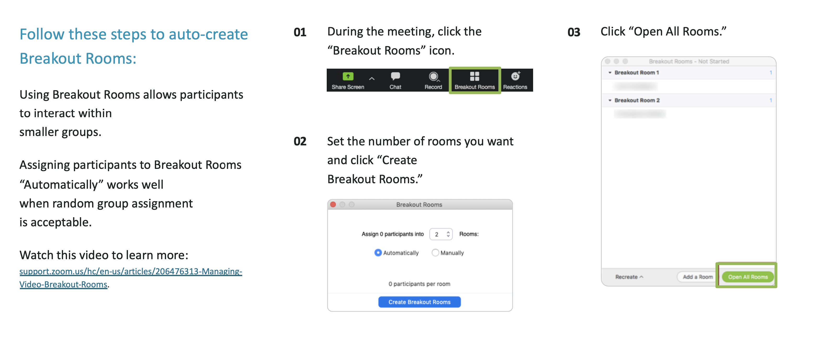
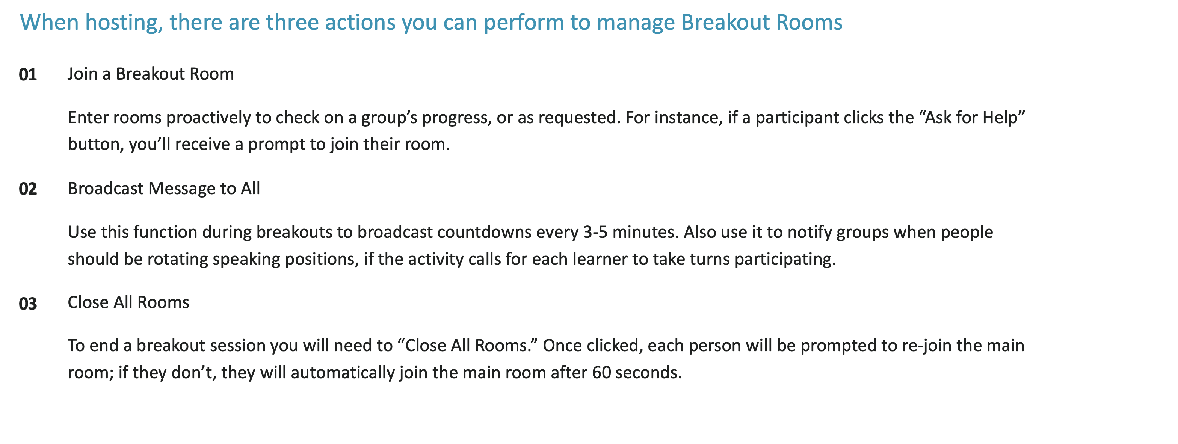
Facilitator Guide
MODULE 02: LAY OF THE LAND
  Tech Considerations:
  Breakout Rooms
  In order for breakout rooms to be enabled you have to be the host of the meeting. So that’s the first step, make sure you are assigned as the host or the co-host of the session.
  Assign 4 students per room with a minimum of 3 students if necessary.

Slide 4
Timing Breakdown
MODULE 02: LAY OF THE LAND
Section | Duration |  | Section | Duration
Welcome + Did you explore more? | 5 min |  | Trey activities | 20-25 min
We’ve got big adventure ahead + Reality check | 2 min |  | Small group: Saving for goals | 10 min
Whiteboard expenses | 5 min |  | Congrats | 1 min
Fixed and variable expenses + Savings as a need | 2 min |  | Roadmap | 1 min
Famous tennis star example | 2 min |  | Explore more | 1 min
Short-term thru Emergency Savings | 5 min

Slide 5

Welcome!
I’m excited
you’re here!
01 Camera on if you can
02 Mic on mute until
you're ready to share
03 Grab a pen and paper
or open a new document
Notes:
[Facilitator note: Log on a few minutes before the start of the module. As students are joining the Zoom, you’ll want to give them instructions of how to prepare. This moment of interaction will both save time later and create an engaging/inviting atmosphere]
Welcome back everybody! If you can, we’d love to have you on camera for this workshop and your mic on mute until it’s time to share! [Facilitator note: It’s best to make “camera on” optional and not try to pressure teens to come on camera]
While you’re getting settled in, gather any notes you took last week. As usual, have a pen and paper handy, or open a new document on your device. Today we’re putting all of our hard work over the past few weeks into action.

Slide 6


Education Content Created By
Your money adventure
02 Lay of the land
Speaker Name | Speaker Title
Date
Notes:
[Facilitator note: Once all students have joined and turned on their cameras, you give a more formal introduction]
Welcome back everybody! Great to see all of you again!
I hope you’re as excited as I am about all this money talk! My heart beats a little faster just thinking about it because I KNOW that what you learn here can give you freedom down the road.

Slide 7


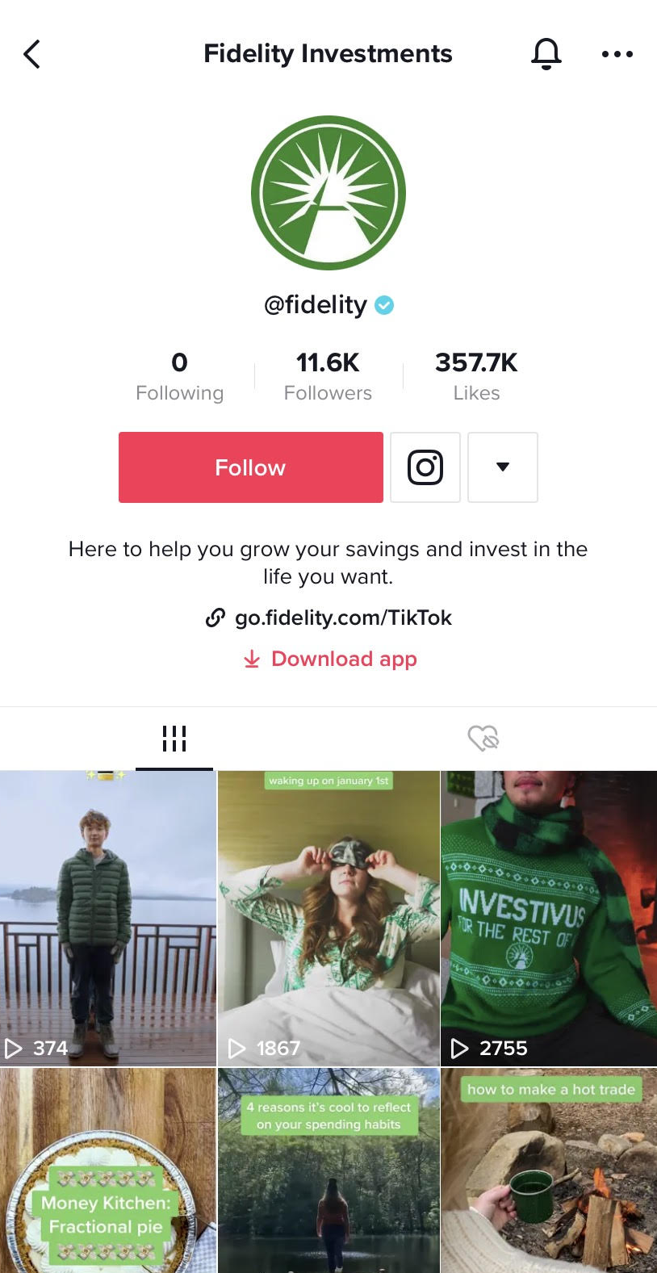
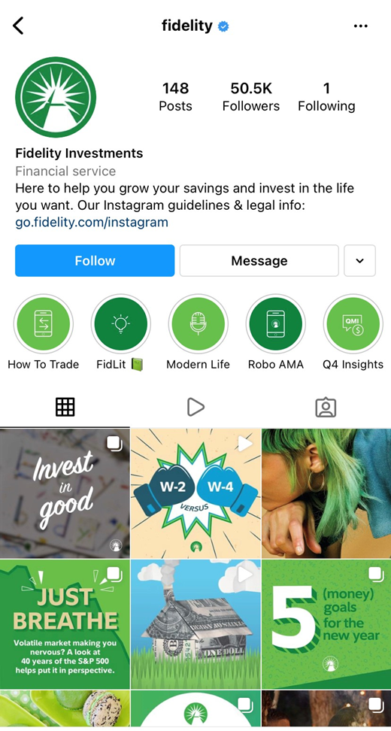

TikTok
Explore
more!
Instagram
Images for illustrative purposes only
Notes:
We ended last week with this way to explore more. Did anyone get a chance to do it?
[Facilitator note: give it a beat, they may not want to look like a try-hard jumping into the extra credit.]
Or maybe something else about money popped up in your social media feeds and you noticed it instead of just scrolling by.
[Facilitator note: If yes, great! Let them point out some interesting things they discovered. If not, that’s ok too. You can point out a few things you may have noted when you searched Fidelity’s social pages– e.g. “I really like how seemingly hard concepts are simplified in this Fidelity post.” Make it a discussion to get folks talking. E.g. Do you use social media to learn about things you’re interested in? Have you seen financial information/education on the sites you use?]
There’s a lot out there to explore, and I’ll give you more ideas each week in case you’re interested.

Slide 8


03
05
01
Build your roadmap
Strategies for spending smart
Adventure awaits
Financial know-how in action
Let the adventure begin
Short-term/long-term goals
04
02
Boost
your plan
Jump into investing
Lay of
the land
Savvy saving habits
Notes:
We ended last week putting our pens to paper (so to speak) and getting our goals down in writing. We’ve dreamt up some pretty exciting adventures (both for the short- and long-term) and that’s a great start, but...
To get there we’ll need to be smart about our spending and we’ll need to start saving. This will be our focus for the next two weeks.

Slide 9






Notes:
Let’s start by just thinking about the basics. The reality is, stuff costs money! LIFE costs money.
There are certain things we HAVE to spend our money on to live, but there are also things we GET to spend our money on. Things that bring us joy and community, things that just make us happy, and things that help us prepare for the future.
Sure, there’s a difference between needs and wants, but both are valid and important parts of spending the money we work hard to earn.
But you want to be smart about it – the first step in coming up with a smart spending and saving plan is to list out all of your expenses.

Slide 10

Notes:
[Facilitator note: You should add a screenshot of the list from Module 1 to this slide]
Last week you brainstormed all of the things in your lives that cost money. Let’s head back to that list. Here’s a screenshot from our white board last week – here they are...ALL of this group’s collective expenses. For this exercise you’re going to need a sheet of paper or a word doc open.
I want you to take what you see on this board and imagine these are YOUR expenses. For the next 3 minutes I want you to divide these expenses into two categories – wants and needs. Some of these can be tricky. What may be a want for one person could be a need for another...
[Give 2-3 minutes depending on how much on list]
Okay, great! I’d venture to guess, even though we’re all working with the same list, the way we’ve categorized things under wants and needs will probably vary based on where you are in life and what your priorities are.
What could we call out as a universal NEED on this list? [give them a second to answer or offer an answer yourself]. What could we call out as a definite WANT? [give them a second to answer or offer an answer yourself]. What on this list falls under that GRAY area? Perhaps it’s a want for you now, but you can see it becoming a need in the future. [Let them respond. Here’s an opportunity to have some discussion around that gray area and how one might prioritize]
The key takeaway here is that it’s important to know what your expenses are and to think through what things are truly needs and what things are wants. And know it’s gonna change. Those changes could be based on YOU changing, but also, prices change.

Slide 11


JAN
$32.00
$34.00
$36.00
$41.00
$42.00
$46.00
$47.00
$45.00
$49.00
$48.00
$50.00
$52.00
$9.99
$9.99
$9.99
$9.99
$9.99
$9.99
$9.99
$9.99
$9.99
$9.99
$9.99
$9.99
JAN
FEB
FEB
MAR
Variable vs. Fixed
MAR
APR
APR
MAY
MAY
JUN
JUN
JUL
JUL
AUG
Streaming service
AUG
SEP
SEP
OCT
OCT
NOV
NOV
DEC
DEC
Images for illustrative purposes only
Notes:
We call expenses where the cost changes often “variable expenses” because the price varies. They could change every year, every month, or even every day! Like gas for your car. You see those numbers on the gas station sign go up and down all the time! Most expenses are variable and increase with time and keeping an eye on your expenses can show you how little differences can accumulate to a lot on an annual basis.
Groceries are another good example of a variable expense. You might have noticed the price of food going up during the pandemic.
Then there are expenses that stay the same for a long period of time. We called those “fixed expenses” because they don’t change often. For example, a streaming media subscription costs the same every month—well, until they raise the prices one day…but for a relatively long period of time, the price stays the same each month.
When you keep an eye on your expenses, you can be more prepared for any changes that pop up.

Slide 12






Notes:
There’s one more expense that we want to call out that probably didn’t make it on your need list just yet.
Savings.
A lot of people think about savings as a “nice to have” or a “want.” But when you treat savings as a “need,” as a mandatory expense you put aside each time you get money, then contributing to your savings becomes a way to pay yourself.
There’s huge value in putting away your money today for something you want in the future. Savings can be for things you want to save for in the short-term and things you want to save for in the long-term.

Slide 13

  She just didn’t want to become a statistic, or one of those athletes that had it all and then in the end had nothing. That was at the back of her mind, so it made her want to be more
  realistic with how she spent money.
Famous tennis star
Notes:
One of the greatest athletes of all time famously deposited the first million she earned in her bank account and just....... left it there.
She just didn’t want to become a statistic, or one of those athletes that had it all and then in the end had nothing. That was at the back of her mind, so it made her want to be more realistic with how she spent money.
You’ve probably heard this can happen. Can you think of any celebrities who made a lot of money but spent it all too fast?
[Give them a chance to chime in – you can throw in a few examples as well].
Sadly, the story of having it all and then having nothing isn’t all that uncommon. We hear it quite a bit from folks who make it rich quick – athletes, musicians, movie stars – but spend it quick too.
One of the smartest ways you can spend your money, is to do like the G.O.A.T did – think of your savings as another expense and file it under the need category.
Now, it’s important to note there are different kinds of savings, with different purposes and types of benefits. Let’s play a matching game to test our knowledge of what different types of savings could be used for.

Slide 14








Match the saving type to the different saving goal
A
B
C
D
E
Emergency
Short-term
Intermediate
Long-term
401k plan
Prepared for
the unexpected
  Money set aside for something coming up
  A little more money than you started with
  Money grows over time with investment earnings
  Money match from your employer
Notes:
What you see across the bottom of your screen are a range of savings types. You’ve got the emergency fund, short-term savings, intermediate savings, long-term savings, and a 401K plan. Those different types of savings connect to different goals, which you’ll find represented by the icons above.
Let’s say you’re setting aside savings
For new soccer gear for your upcoming season,
To buy your first car when you turn 17 in two years,
You’re saving because you’re eager to take advantage of money match from your employer (that sounds nice!)
You’re saving for your next phone because you’re notorious for breaking yours
And you’re saving because you’re interested in investing early and want to watch your money grow.
Let’s match up the type of savings to the savings goal. We’ll start with the most important – emergency savings. This would be connected to which of the goals you see above? Feel free to come off mute or pop it in the chat. [Let them answer] Yes! Putting aside money because you know your history of breaking your phone is a type of emergency savings. The benefit? You’re prepared for the unexpected expenses that may come your way.
How about Short—term savings. What goal would we connect that to? [Answer] You got it! Your soccer season is right around the corner so now’s the time to set money aside so you’re geared up and ready when the season starts.
What about intermediate savings? [Answer] – If you guessed saving for your first car in two years, you’d be right! Intermediate savings let you set some money aside and earn a little extra money called interest, so you’ll wind up with more than you started with.
Ok, only two left. How about that long-term savings? [Answer] Right, investing is a type of long-term savings. When you’re ready to put money aside and invest it, it can make a huge difference down the road!
Here’s the last one – the 401k plan and I bet you all were excited when I said the words Free Money! Yes! This is when your employer offers a matching contribution to your 401(k) or 403(b) plan!
The last two types of savings – long-term and 401k are where you could really get more bang for your buck so they deserve a little further explanation....

Slide 15

Save $20 dollars
every month
until you’re 65
AGE YOU
START SAVING
MONEY
AT AGE 65
15 yrs.
$12,000
25 yrs.
$9,600
35 yrs.
$7,200
Images for illustrative purposes only
Notes:
When we talk about long-term savings we’re talking about the stuff really really far down the road. Setting aside money for the long-term is how you can really make investing work FOR you.
Here’s a quick example.
Imagine if you saved $20 a month until you were 65...I know, 65 is a long time away. But let’s play this out.
If you started at 15 years old, you’d have $12,000 dollars.
If you waited until you were 25 years old, you’d end up with $9,600.
And if you waited even longer until you were 35 years old, then you’d only have $7,200.
And that’s without any interest or investment growth, which you could earn along the way.
In fact, let’s do another long-long term savings example to show you how interest could come into play.

Slide 16
Save $20 dollars
every month
until you’re 65
Invest $5 dollars
every month
until you’re 65 (7% rate of return)
AGE YOU
START SAVING
MONEY
AT AGE 65
AGE YOU
START SAVING
MONEY
AT AGE 65
$12,000
*
15 yrs.
15 yrs.
$26,000
$9,600
*
25 yrs.
25 yrs.
$12,800
$7,200
*
35 yrs.
35 yrs.
$6,000
Although investing and compounding may help you grow your money, please remember that investing involves risk. You could lose money, investment returns are likely to fluctuate, and investing on a regular basis does not ensure you’ll make more money. These examples are hypothetical and don’t reflect the performance of any specific investment.
*This hypothetical example assumes the following: (1) a $5 contribution is made on January 1 and every month until age 65,
(2) an annual rate of return of 7%, and (3) the ending values do not reflect taxes, fees, or inflation. If they did, amounts would be lower.
Notes:
We’ll talk more about investing in a few sessions, but for now let’s say you put away $5 a month into a retirement plan with an average rate of return of 7%. If you started at 15, you could have $26,000 by the time you were 65!!!
Now if you don’t start til 25, you could wind up with right around $12,800. Not bad, but that’s a significant chunk less.
And if you wait until you’re 35 to put money away towards long- long-term savings, you could end up with just a little over $6,000.
That means you could miss out on over $20,000 of potential compounding growth!
Now you might be thinking “Ok, I don’t have a lot of money now, but when I’m 35 I’ll be able to save way more than $5 a month. I can probably save $20 a month by then.
Ok, but then based on this illustration, you could still only come out to $24,258 by the time you’re 65! That’s still less than you may have if you only put in $5 a month starting at 15!
It’s really hard to “make up for lost time,” and it usually ends up costing you more money to do it.
Keep in mind, these illustrations are hypothetical, investing does involve risk and the risk of losing money.

Slide 17

  Some employers will
  match your retirement
  contributions
  That “free money” match is
  yours forever, even if you leave,
  as long as you are vested.
Notes:
And then there's the "free money match" some companies will put in a retirement account FOR YOU. ​
​
When you go out into the workforce your company might even offer a retirement plan that can help you save for the long-term. They have different names, but you might hear the terms 401(k) or 403(b). Usually, you can contribute to these types of accounts with pre-tax dollars (meaning money you have not been taxed on yet). And if a company ever offers you a match in your retirement account, be sure to take advantage of it. It’s like free money!
Again, we’ll go into more detail on this stuff once we get into investing. That’s where you’re really see the power of Compounding interest.

Slide 18
Help us
achieve
our goals!
Expenses
Savings
Setting aside money
Cutting down
on our wants
Notes:
Ok, so now we have a solid understanding of why savings are so important. Setting aside money to save helps us have those adventures we dreamed up last week. We’ve got to save for them. And there are multiple ways we can do it.
We talked about expenses and how we might categorize them according to wants and needs and we know contributing to savings is essential to achieving our goals in the short- and long-term.
With that in mind, I’d like to introduce you to somebody...

Slide 19



















Notes:
Meet Trey. He’s 17, a senior in high school, and works part-time at a local athletic store.
He’s super excited about his senior year because he’s got a lot to look forward to:
* Senior Week activities are right around the corner.
* And Trey just got accepted to his dream school. He worked really hard to keep his grades up and can’t wait to start college in the fall.
Needless to say, there’s lots of adventure ahead for Trey, but he’s gonna need to be smart about saving for all the stuff coming his way.

Slide 20



$650 (3 months)
Senior Week
Laptop
Emergency
$200
$350
$100
Notes:
So our buddy Trey has got some savings goals!
He’s been looking forward to Senior Week since his freshman year. He does NOT want to miss out! But he knows he’s gonna need to set aside $200 between now and Senior Week to pay for it all. [CLICK]
And Trey can’t wait for college but since he’ll be going away for school, he’s gonna need his own laptop. His parents said they’d help him out if he paid for part of it, so his goal is to save $350. [CLICK]
And third, Trey’s a pretty practical guy. His goal is to set aside $100 for an emergency fund. [CLICK]
Now here’s the kicker, he’s only got 3 months to save it all and that adds up to a whopping $650! That’s a lot to save for but not impossible if Trey can make some changes to his spending habits.
We’re gonna take what we learned today and help Trey figure out a plan so he can spend smart and save for his goals.

Slide 21
Retail job | +$540
FIXED
Monthly transit pass | -$30
Gym membership | -$13
Phone plan contribution | -$35
VARIABLE
Snacks | -$48
Morning beverage | -$80
Meals | -$75
Clothing | -$100
Personal care | -$30
Entertainment | -$50
Notes:
Like I said, Trey works retail and he gets paid around $540 a month at his job. Of course, a lot of that money goes to everyday expenses. So, here’s a list of Trey’s typical monthly spending.
[CLICK]
His monthly transit pass is $30, his student gym membership is $13, and his phone plan contribution is $35. Would you consider these expenses fixed or variable? Pop it in the chat. [Pick a name from the chat who selected fixed and ask them to explain why these are fixed expenses].
Not only are these fixed expenses (because they don’t change), but Trey considers these NEEDS – they’re priorities for him...let’s lock those in.
But Trey gets out, has a social life, enjoys a smoothie from his favorite donut shop regularly. When we take a closer look at his spending habits, here are some of his wants:
[CLICK]
He spends around $48 a month on after school snacks, $80 on his morning beverage (try not to judge, we all have our vices), $75 on meals, $100 on clothing (he’s gotta look good at his retail gig), $30 on personal care, and around $50 on entertainment activities like movies with friends, his High School’s Battle of the Bands, and in-game purchases for his favorite video game.

Slide 22
Retail Job | +$540
Current savings
FIXED
$79
Monthly transit pass | -$30
Gym membership | -$13
Phone plan contribution | -$35
Additional savings needed
(per month)
VARIABLE
Snacks | -$48
Morning beverage | -$80
Meals | -$75
Clothing | -$100
Personal care | -$30
Entertainment | -$50
$138
Savings goal (per month)
$217
Total expenses | $461
Notes:
When we add it all up, that’s $461 in expenses per month, leaving Trey $79 to put towards savings each month. That’s just not gonna cut it if he wants to reach his goals. Trey will need to set aside $138 every month if he’s serious about his goals.
Now I know that sounds like a lot...but Trey is committed! Annnnd can admit he might be overspending in some categories. In fact, when he put it all together – he noticed some really glaring examples of places, he could probably stand to spend quite a bit less.
Now, he’s locked those top expenses because he considers them Needs, but everything below is up for grabs. He’s ready to change his spending habits so he can save for his goals, but we know wants are important too. Before we help him cut back on some spending so he can focus on his goals, what are some questions we could ask Trey so we can be sure we’re taking his point of view into consideration? After all, this is HIS spending and savings plan so we want to make sure it works for him – so what are some questions we might ask him? [Possible questions may include – Is there anything on this list that makes you really happy? What stood out as an area that you realized you may be spending too much? Of all these wants...what is the most important and what is the least important? You don’t have to answer these questions – we just want them to be thinking about this stuff. They can invent who Trey is and what he cares about in their own minds]
What I want you to do is take the next 5 minutes to work on your own and come up with a few ways Trey could curb his spending. It might mean spending less in a few categories or eliminating a category altogether. I’ll keep this screen up so you can use it for reference. Keep in mind, we’re trying to find an extra $138, give or take. There are lots of ways you could go about this so be prepared to share what you come up with (and why!) when we come back together.
[5 minutes - or when it looks like folks are popping their heads up – if on camera]

Slide 23
Retail Job | +$540
Current savings
FIXED
$79
Monthly transit pass | -$30
Gym membership | -$13
Phone plan contribution | -$35
Additional savings needed
(per month)
VARIABLE
Snacks | -$48
Morning beverage | -$80
Meals | -$75
Clothing | -$100
Personal care | -$30
Entertainment | -$50
$138
Savings goal (per month)
$217
Total expenses | $461
Notes:
Ok, I’m eager to hear what you all came up with and understand your rationale behind the choices you made. Who wants to share first?
[Depending on time, get 2-5 people to share back. Work out the math and narrate aloud as they’re sharing – e.g. “Cut back on the after school snacks? Narrow it down to 2x a week? Ok, that’s $16. Half that clothing budget? Great, so $50 there. We’re up to $66 in savings already.” When the other students chime in show the differences...ask about rationale...some students may say, ”I picture Trey as somebody who needs his coffee fix so even though it was a large expense, it was important to him, so I left it and cut in other places.” OR “Trey spends a lot on fun and entertainment but I bet he could find some pretty great free stuff to do with friends, especially for just 3 months.” Try and draw out these insights from students or share some yourself to get them thinking critically.]
These are all really good ideas! And cutting back leaves a good amount of extra money on the table. I’m curious, beyond what we’ve already said, what other recommendations do you have for Trey to help him reach his goals? [invite discussion – if it doesn’t come up make sure to highlight how Trey could add to his income, maybe pick up a few extra shifts, babysit, walk a dog in his neighborhood, etc.]

Slide 24

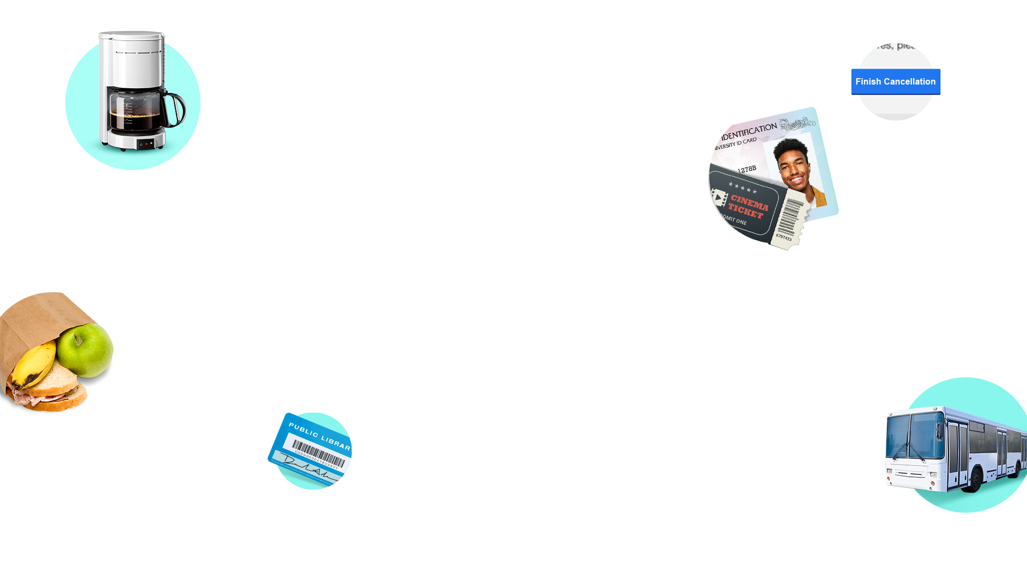
List all the ways
in your life that
you can save money
Notes:
We’ve helped Trey, now let’s take a few minutes to help ourselves. What are some ways you might be able to set aside some extra money for the goals you set for yourselves last week?
I’m about to send you into breakout rooms with a small group. I want you to spend the next few minutes brainstorming your answer to this question. I’m talking about simple things like – looking around for the best deal instead of impulse buying or making that smoothie at home instead of buying it.
Did you know you can get a lot of video games for free from the library? Or that some theaters offer student discounts? And when it comes to free activities, you might be pleasantly surprised at what your area has to offer!
So, head off into your breakout rooms, come up with some ideas, and report back about how we can save more. Brainstorm ways to save, search fun free stuff in your town, finally figure out where that popular hiking trail is, think of how you might be able to earn some extra cash...you get the idea. You’ve got 5 minutes. Any questions? Ok, pick someone in your group to write down your ideas and be ready to share when you get back.

Slide 25
List all the ways
in your life that
you can save money
Notes:
Welcome back! How’d that go? Did we come up with some good ideas?
[Facilitator note: If time is running short, just have them pop a few ideas in the chat and call out a few. If there’s time – Alright! I want to hear it! Give me your best ideas about saving more towards your goals!]
These are great! You’ve come up with some really simple ways to save! And don’t forget, there are always opportunities to earn more money if you need to.
Just think about what you can do with those extra savings. You could save for the short-term, the long-term... OR really see how those extra nickels and dimes could add up to more dollars in the long- long-term! I’m talking about financial freedom here!
Did I pique your interest? More on that in a few weeks. As for now...

Slide 26



You’ve finished this
session and earned
an eyes on the
future pin!
2/5
completed!
Let’s collect them all!
?
?
?
Notes:
Congratulations! You’ve mapped out your expenses, have a better sense of the importance of saving, and understand how adjusting your spending and saving can help you achieve your goals.
Which means you’re another step ahead in our money adventure! Congrats you’ve earned another pin!

Slide 27
03
05
01
Build your roadmap
Strategies for spending smart
Adventure awaits
Financial know-how in action
Let the adventure begin
Short-term/long-term goals
04
Lay of
the land
Savvy saving habits
Boost
your plan
Jump into investing
Notes:
When it comes to the adventures you seek, getting the lay of the land by mapping out spending and saving is an important step.
But in addition to being smart savers, we’ve got to be smart spenders. And that’s where we’ll focus our energy next week.

Slide 28
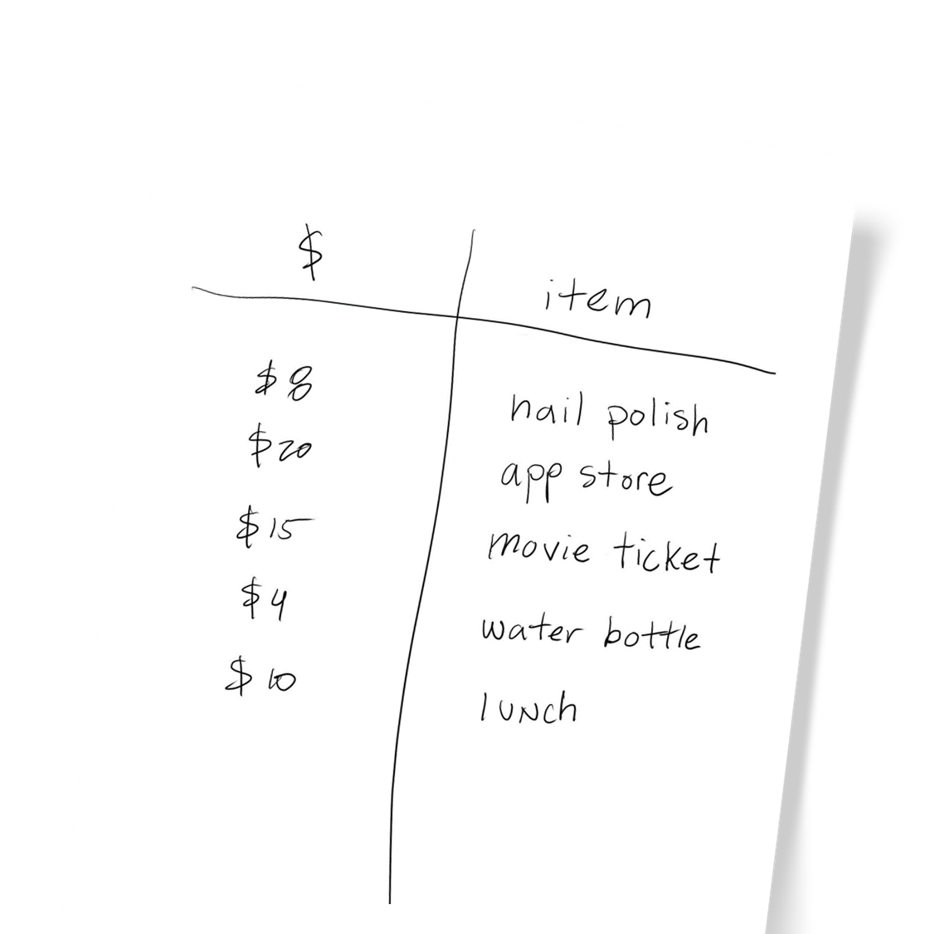
Explore
more!
Track your
spending this week
Notes:
For those of you who can’t wait until next week, here’s a way to explore a little more:
Keep and eye out for how much stuff costs and track all of your spending over the course of the next week. Or if you aren’t spending it yourself, start to track things in your life that cost money even more closely, or look at prices of things to get an idea of how much stuff costs. Keep a master list every dollar...every dime ... that goes out. Gas? Make a note. A candy bar after school? Make a note. In app purchase? Make a note. Throw a dime into a wishing well? Note it!
Write it all down and start to get a big picture of what everyday spending habits look like and how much stuff costs.
I’ll see you all next week!

Slide 29

Investing involves risk, including risk of loss.
The third parties mentioned herein and Fidelity Investments are independent entities and are not legally affiliated.
Fidelity Brokerage Services LLC, Member NYSE, SIPC, 900 Salem Street, Smithfield, RI 02917
© 2022 FMR LLC. All rights reserved.
1019501.3.0

